Slide 1
BIZ-VIZ
TEAM--SEGMENTATION_FAULT

Slide 2
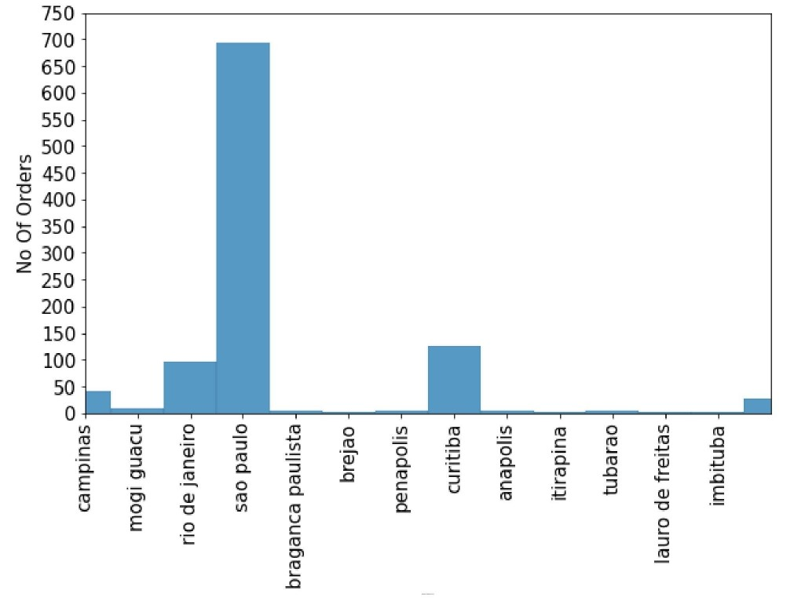
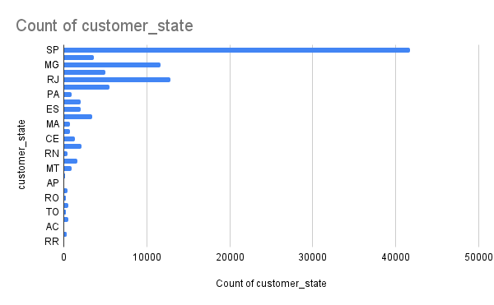
Count of Customers vs Customer State
Plot between the number of orders with their respective cities of sellers
No of Sellers
Count of Customers
Seller’s Cities

Slide 3
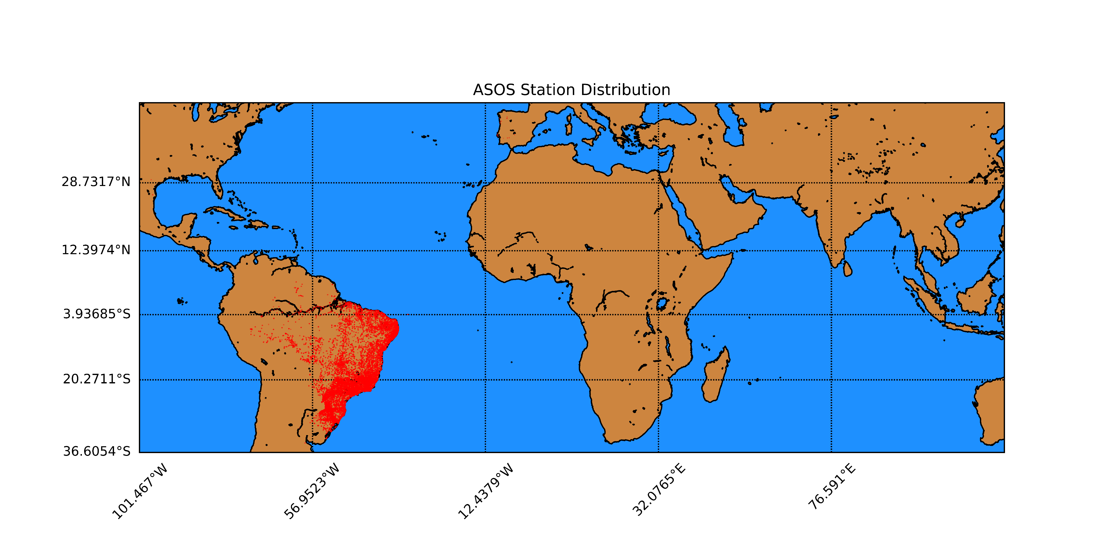
Plot of the location of customers

Slide 4
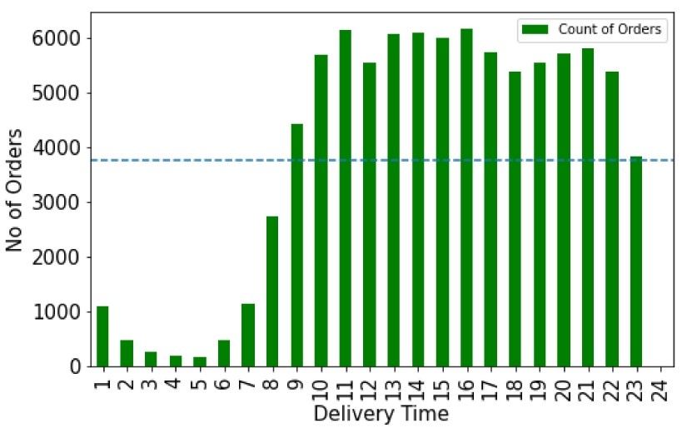
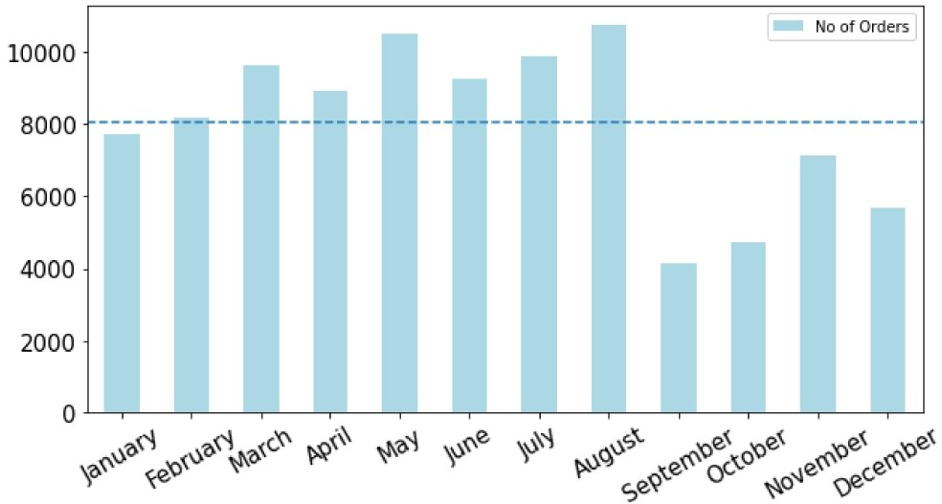
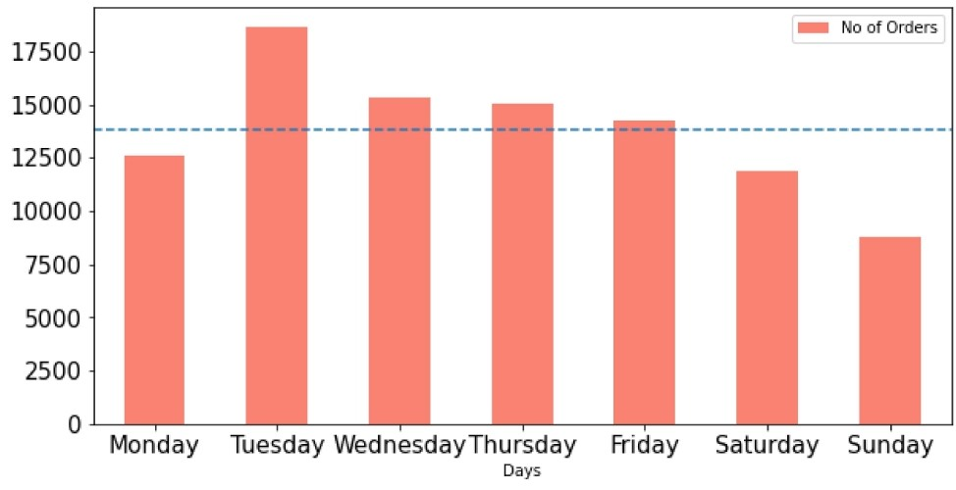
Delivery Hour
Graph of number of orders placed during a particular hour.
Graph depicts the order placed during a particular month
← Number of order placed On each day throughout the year

Slide 5
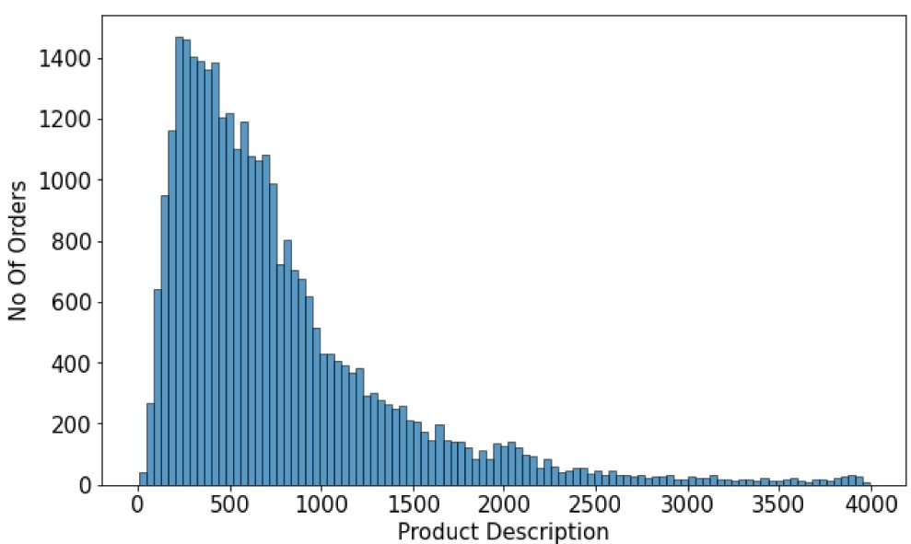
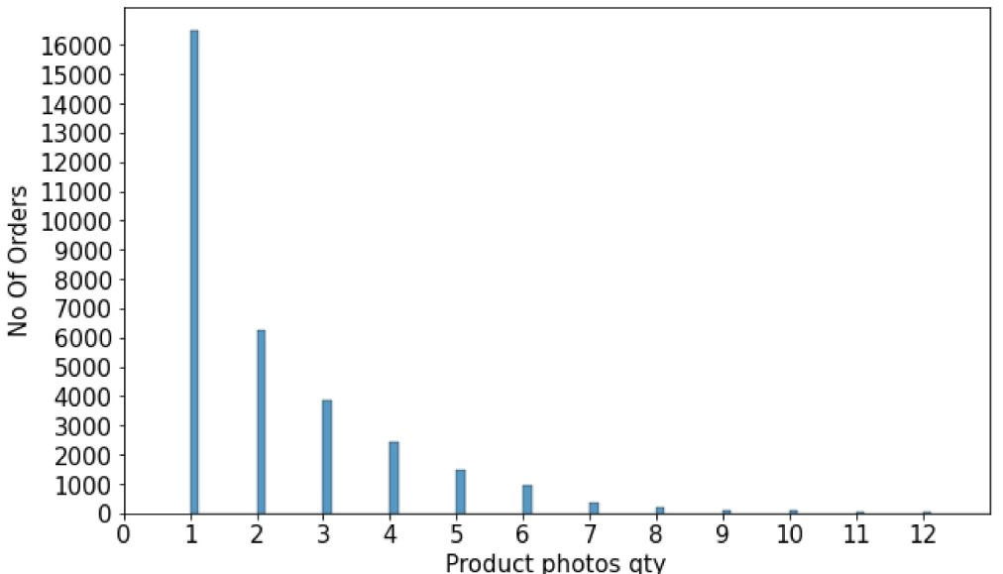
Analysis : Product Description Matters!

Slide 6
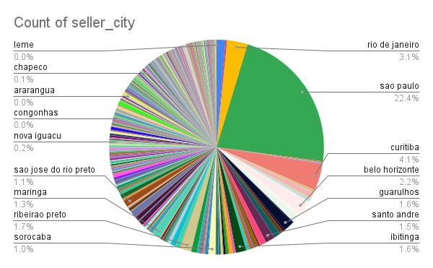
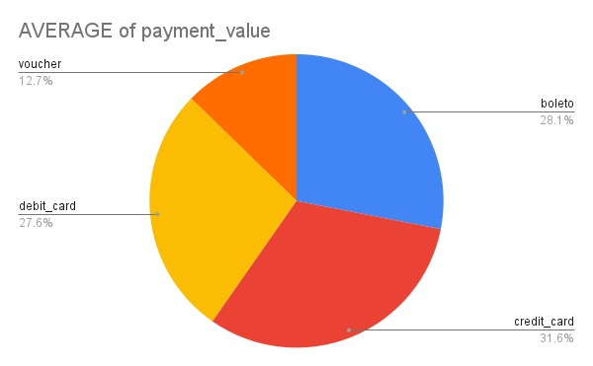
Pie Chart of Seller Cities
Mode of Payment Used By Customers
Pie chart of percentage of seller in cities
Different Payment Methods Chosen By Customers

Slide 7
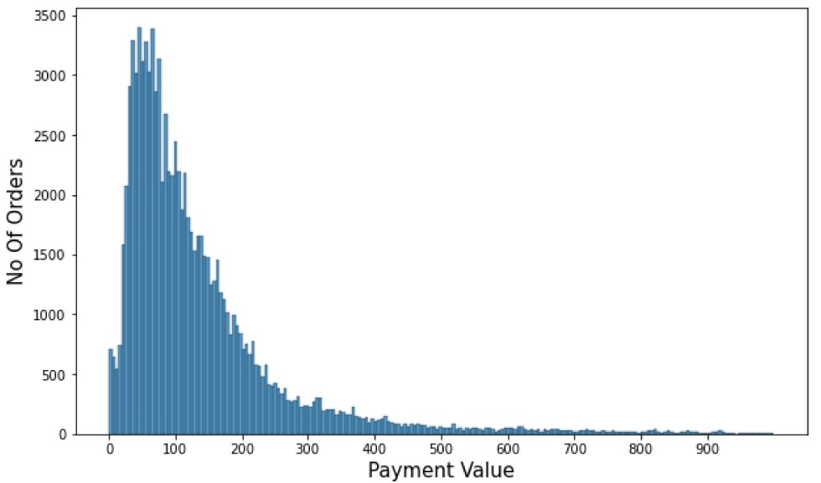
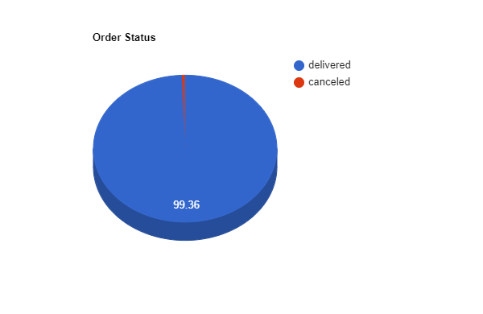
This plot shows us Order Value V/s No of Orders
Order Successfully Delivered Vs. Cancelled orders

Slide 8
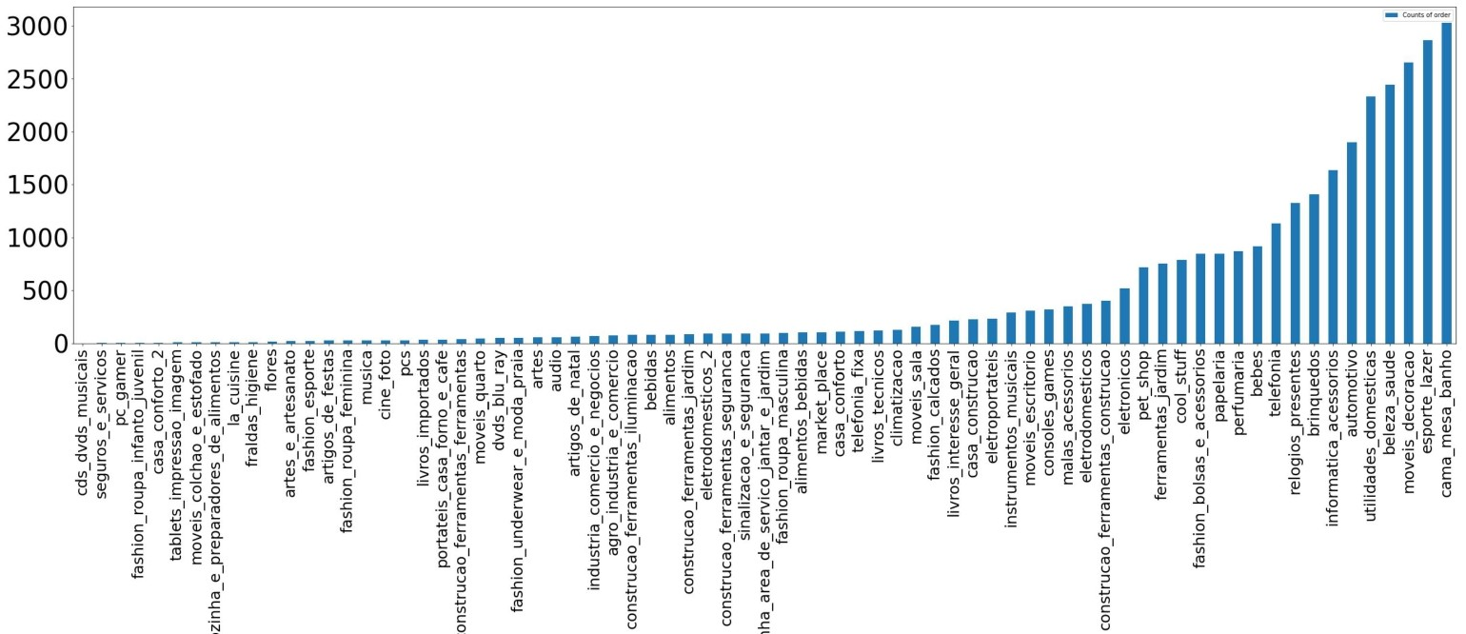
Interesting takeaway!
This graph follows 80-20 rule.
Around 80% of the sales are from the 20% percent of the products categories.
Product Category(X)
V/s
No of Orders(Y)

Slide 9
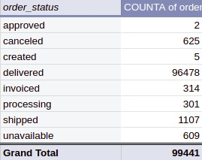
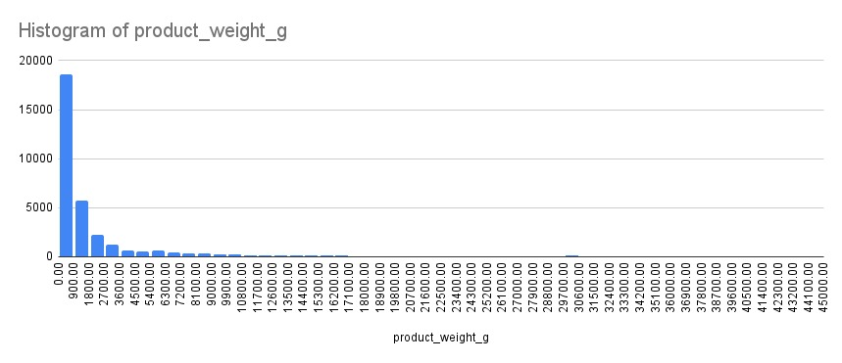
Order Status
Order Count
Good Sign!
More than 99% orders are delivered successfully!
Histogram of Product Weight V/s product count
75% of products are less than 2kg.
Product Count

Slide 10

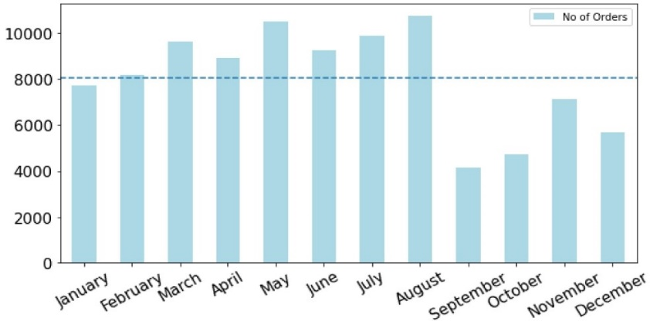



Slide 11
Thank You
Credits:
Aarav Jain
Falak Singla
Chandan Rakholia
Aditya Takkar
Source code->https://github.com/Aarav030914/Biz-viz

